Slide 1
Sanctions and Russian Online Prices
By J. Benchimol and L. Palumbo
Discussion by O.Talavera

Slide 2
The paper is about
Analysis is based on daily web-scraped data which provides valuable high-frequency signals about macro-level indicators
Micro level data are aggregated to indices
Cointegration is checked using online-price index and official statistics
Forecasting/Structural Breaks/Causality to established the impact of the war and associated sanctions on both official and online prices in Russia for different categories of goods, both before and after (escalation of) the war.

Slide 3
Main Results
There are significant differences in price dynamics following Russia’s full scale invasion of Ukraine, which can be attributed to the international economic sanctions.
Sanctions may have led to an average excess CPI level of 11.7% for Russia.

Slide 4
1. Positioning
Sanctions, including sanctions against Russia, 2014 and 2022: Korhonen et al. (BOFIT WP 2018); Belin and Hanousek (JCE, 2021)
Reliability of CPI/Macro measures/Nowcasting: Cavallo (JME, 2013); Faryna et al. (Visnyk NBU 2018); Martinez (JPE 2022).
Supply driven shock/availability and price setting: Cavallo et al. (RIW, 2014); Nikolsko‐Rzhevskyy et al. (EI, 2023).

Slide 5
2. Reliability & Index Measures
Are the data coming from “Your House” representative?
Gorodnichenko and Talavera (2018) – higher flexibility on online prices, lower menu cost, higher competition, etc.
But what about own branded goods price setting?
Sales?
Bonus programs
Aggregation
Product replacement/life cycle
Availability?
Availability (stockouts) could be taken into analysis? Antoniades et al. (AER 2022) expenditure shares could be approximated using share of outlets selling an item.

Slide 6
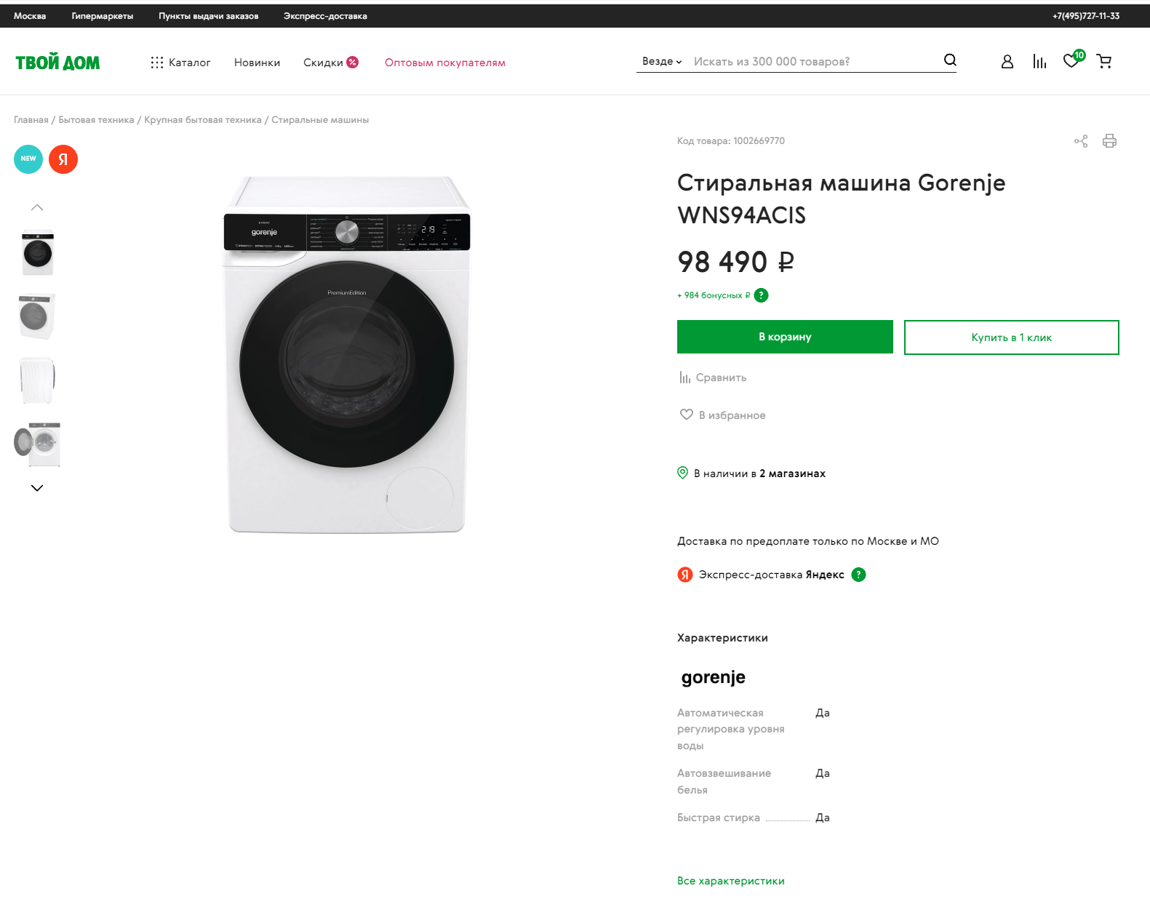
Good characteristics
Price
Availability in Number of shops

Slide 7
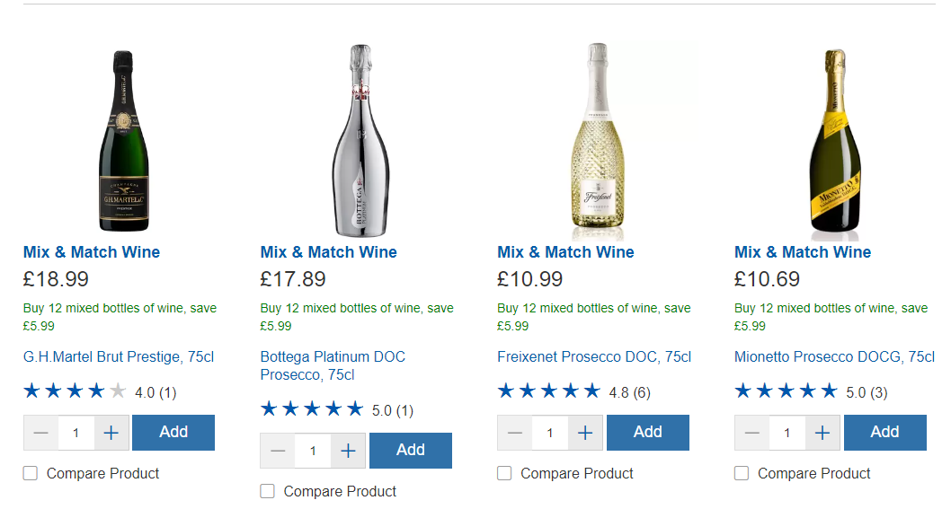
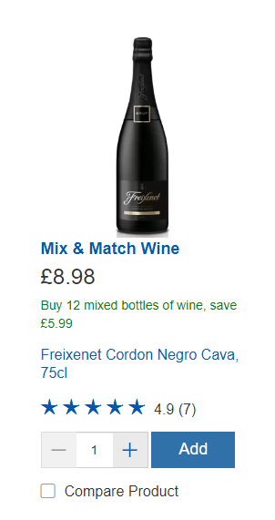
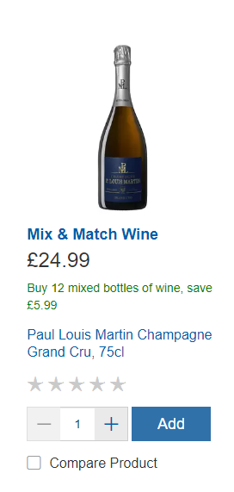
3. Approach: Why time series approach?
I was looking for a microlevel analysis: e.g. DiD
Prosecco vs champagne

Slide 8
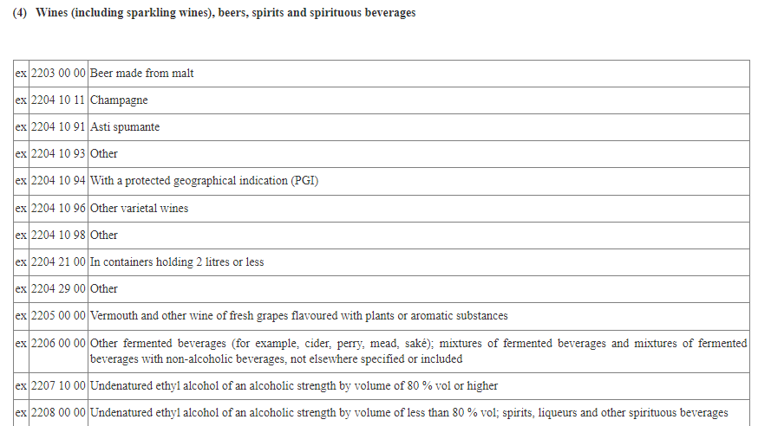
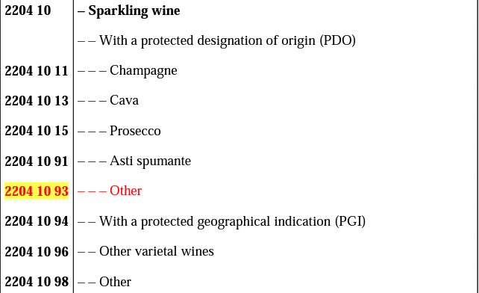
Luxu
Link
Link

Slide 9
3. Approach: Why time series approach?
I was looking for a microlevel analysis: e.g. DiD
Prosecco vs champagne
sanctions
sanctions

Slide 10
4. Sanctions and Structural breaks
Cavallo, A. and Zavaleta, G.G., 2023. Detecting Structural Breaks in Inflation Trends: A High-Frequency Approach.

Slide 11
Overall
Great well-written paper with great data
Many potential ways for extensions
It would be a good idea to combine Time Series approaches with Panel Data setup.

